Slide 1
Measures of Central Tendency and Measures of Spread Revision
Paper 1: Simple measures of average
Averages from Grouped data
Linear Interpolation
Measures of spread
Outliers
Paper 2: Simple averages
Harder measures of average
(incl Geometric Mean)
Measures of spread
Outliers
MEASURES OF AVERAGE AND SPREAD:
Always use the appropriate measure of spread for the average you can calculate/read off
MEAN
MEDIAN
MODE
OUTLIERS:
GEOMETRIC MEAN

Slide 2
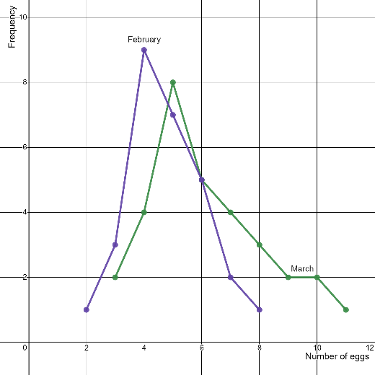
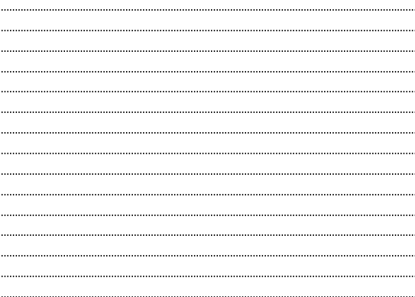
1
The frequency polygons below show the numbers of eggs collected by Conor from his hens during February and March 2021.
Comment on the distributions

Slide 3
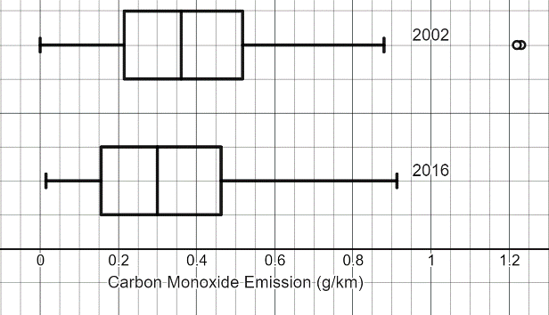
2
The box and whisker plots below show the carbon Monoxide emission for a sample of 100 cars manufactured in 2002 and a sample of 100 cars manufactured in 2016.
Comment on the distributions

Slide 4
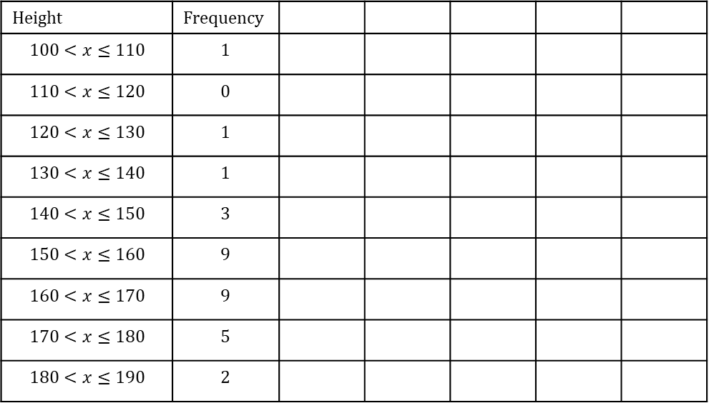
3
Calculate and estimate for the mean and standard deviation of this data set, you must show all your working:
Height | Frequency
$$100<x≤110$$ | 1
$$110<x≤120$$ | 0
$$120<x≤130$$ | 1
$$130<x≤140$$ | 1
$$140<x≤150$$ | 3
$$150<x≤160$$ | 9
$$160<x≤170$$ | 9
$$170<x≤180$$ | 5
$$180<x≤190$$ | 2
Hence identify if there are any outliers in this data.:

Slide 5
4
Calculate an estimate for the median for this data set, you must show all your working:
Height | Frequency
$$100<x≤110$$ | 1
$$110<x≤120$$ | 0
$$120<x≤130$$ | 1
$$130<x≤140$$ | 1
$$140<x≤150$$ | 3
$$150<x≤160$$ | 9
$$160<x≤170$$ | 9
$$170<x≤180$$ | 5
$$180<x≤190$$ | 2
Hence comment on the skew of this data.:

Slide 6
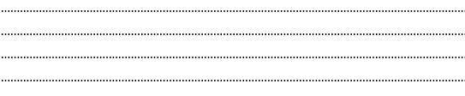

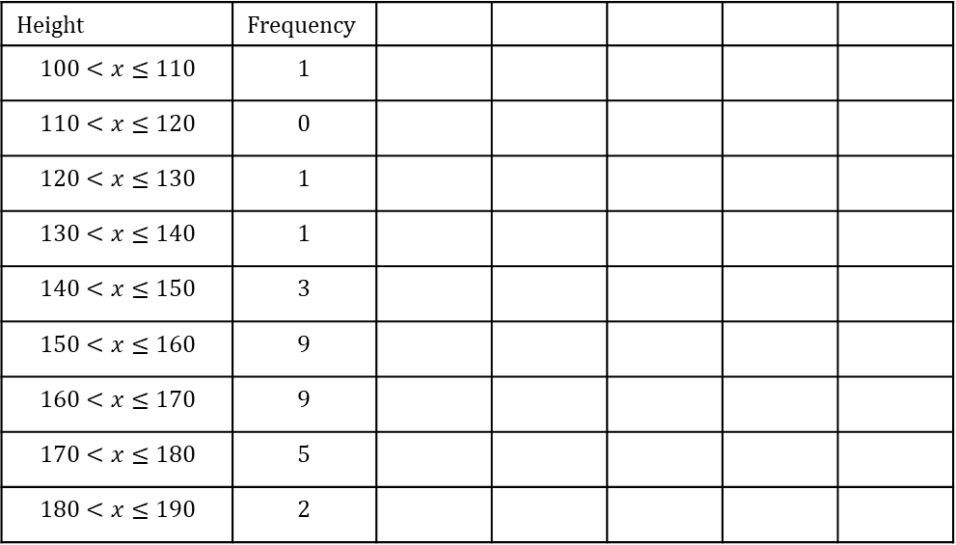
5
Height | Frequency
$$100<x≤110$$ | 1
$$110<x≤120$$ | 0
$$120<x≤130$$ | 1
$$130<x≤140$$ | 1
$$140<x≤150$$ | 3
$$150<x≤160$$ | 9
$$160<x≤170$$ | 9
$$170<x≤180$$ | 5
$$180<x≤190$$ | 2
It turns out one of the data values in the interval $180<x≤190$ had been recorded incorrectly and should have been in the interval $170<x≤180 .$
Without any further calculations, explain the effect this would have on the mean, median and standard deviation :
Mean
Median
Standard Deviation

Slide 7
6
The percentage voter turn out for the last six general elections is given in the table below
Calculate the average voter turn out over the last six general elections
Year | Percentage turn out
2001 | 59.4%
2005 | 61.4%
2010 | 65.1%
2015 | 66.2%
2017 | 68.8%
2019 | 67.3%

Slide 8
7
Cameron has collected data about the engine size of 200 cars.
He has used statistical software to calculate the following summary statistics
Explain how you can tell that Cameron has not cleaned the data.
With reference to the advantages and disadvantages of the different measures of central tendency, explain whether Cameron should use the mean or the median when analysing this data.
Which measure of spread should he use when analysing this data? Explain your decision.
Mean | 1297.3
Standard deviation | 295.1
Minimum | 0
Lower quartile | 1163
Median | 1278
Upper quartile | 1456.25
Maximum | 2350
Range | 2350
Interquartile range | 293.25

